Slide 1

Traffic Light Controller

Slide 2

Participants:
Name | ID
Irtiza Ahsan Abir | 21-45009-2
Ahnaf Abdullah Zayad | 21-45019-2
Srabone Raxit | 21-45038-2
Ashik Ahamed | 21-45368-2

Slide 3

CONTENTS
1. Introduction
2. Component & Description
3. Block Diagram
4. Circuit Diagram
5. Working Method
6. Advantage & Future Scope
7. Advantage & Future Scope
8. Conclusion

Slide 4

1. Introduction
Traffic lights are crucial for managing traffic flow, and a traffic light control system is the technology responsible for regulating the timing and sequencing of these lights. A basic traffic light control system uses two 555 timer ICs and three LEDs to provide stop, wait, and go signals. The red LED means stop, the yellow LED means wait, and the green LED means go. While this simple circuit can be useful for small-scale applications, larger intersections require more complex traffic light control systems. Understanding the basics of traffic light control systems is important to appreciate the technology behind these ubiquitous and essential parts of our transportation infrastructure.

Slide 5
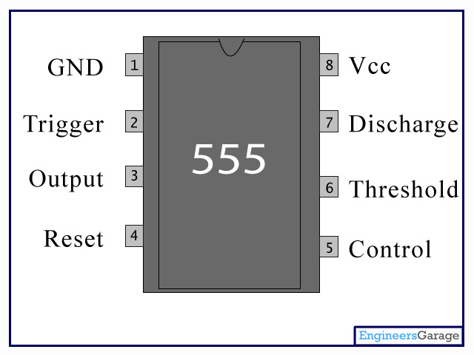
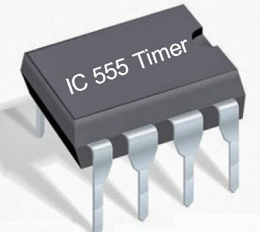
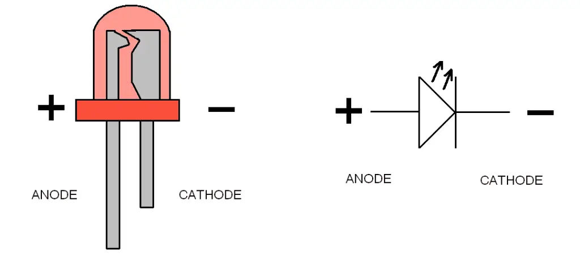
2. Component & Description
i. IC 555
ii. LED
RED 1*1
YOLLOW 1*1
GREEN 1*1
Provide time delay in circuit and also works as oscillator

Slide 6
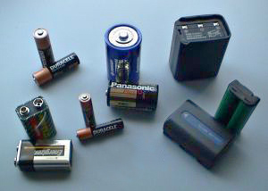
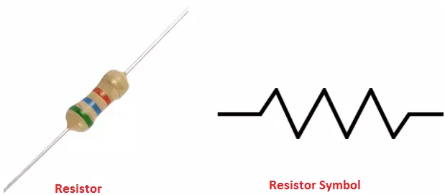
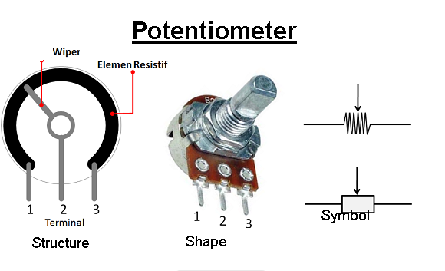
Iv Resistor
a. 2*220 Ohm
b. 1*470 Ohm
c. 2*100k Ohm potentiometer
1*1
iii. Battary

Slide 7

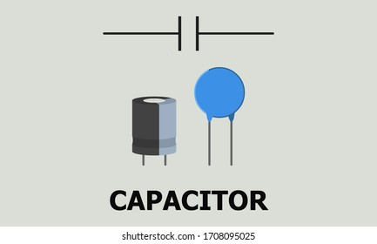
v.Capacitor
store temporarily electrical energy in an electric field
a. 2*100uF

Slide 8
3.Block Diagram
IC 555
Traffic Light
IC 555

Slide 9
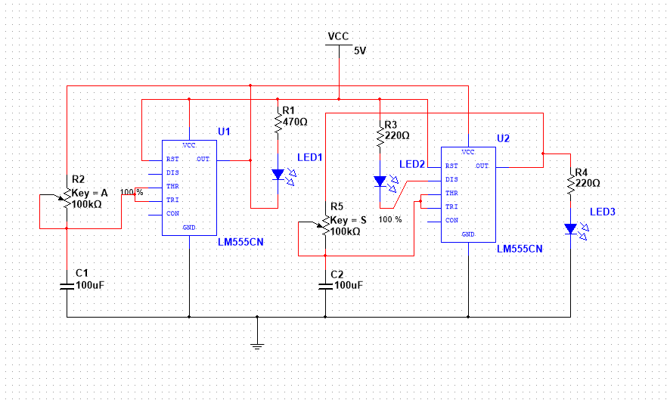
4.Circuit Diagram

Slide 10
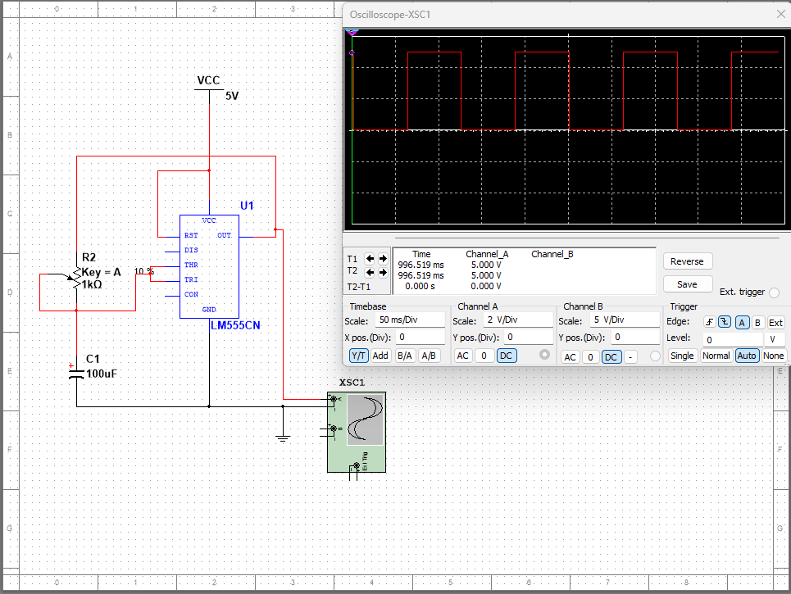
Timing diagram of IC 555

Slide 11

5.Working Method
The circuit is an astable multivibrator that uses two 555 timer ICs to control the blinking of three LEDs. The first 555 timer IC is configured as an astable multivibrator that generates a square wave signal to drive the red LED with equal on-off periods. The second 555 timer IC is configured as a monostable multivibrator that is triggered by the falling edge of the output of the first timer IC. The second timer IC generates a short pulse that turns on the yellow LED and turns off the green LED, and the duration of this pulse can be adjusted using variable resistors VR1 and VR2. The circuit also shows how to connect the LEDs to the output of the 555 timer ICs using external transistors and how to turn off the timer ICs by controlling the supply voltage to their pin 8.

Slide 12


6.Advantage & Future Scope
Future Scope-
1. Using timer and micro-controller, this circuit can become more efficient and automatic.
2. Using methodology of this circuit we can design four way traffic light controller also.
Advantage-
Reduce fuel consumption.
Improve traffic guidance and traffic flow.
Increase safety.
Less cost.

Slide 13

7.Limitations
Excessive delay may be caused.
Disobedience of signals.
The unnecessary delay results in significant fuel waste and higher motorist cost.
This circuit does not contain any type of timer or micro-controller, so it operates manually.
This circuit cannot be used in metro city or where there is more traffic

Slide 14

8.Conclusion
In conclusion, we learned about the basics of traffic light control systems and how they help manage traffic flow, improve safety, and reduce travel times. By understanding the technology behind these systems, we can appreciate the complexity of the infrastructure that keeps our roads safe and efficient. Overall, traffic light control systems are essential for minimizing traffic congestion, reducing pollution, and improving the overall quality of life in our communities.

Slide 15


